Slide 1
What is Big Data?
Lots of Data (Terabytes or Petabytes)
Big data is the term for a collection of data sets so large and complex that it becomes difficult to process using on-hand database management tools or traditional data processing applications.
The Problem is not getting this big data. Problem is how to store, process and analyze this data.
NYSE generates about one terabyte of new trade data per day to perform stock trading analytics to determine trends for optimal trades.

Slide 2














3V’s – Big Data
Web logs
Videos
Audios
Images
Sensor Data
Volume
Velocity
Variety
Veracity
Big Data Veracity refers to the biases, noise and abnormality in data. Is the data that is being stored, and mined meaningful to the problem being analyzed. In scoping out your big data strategy one need to keep the data clean and processes to keep ‘dirty data’ from accumulating in your systems.

Slide 3
What is Hadoop?
Apache Hadoop is a framework that allows for the distributed processing of large data sets across clusters of commodity computers using a simple programming model.
It is an Open-source Data Management with scale-out storage & distributed processing.
Storage -> HDFS - A distributed file system where commodity hardware can be used to form clusters and store the huge data in distributed fashion. There is no need for high end hardware.
Process -> MAP Reduce Paradigm
Analyze -> Hive, Pig MapReduce.
It can easily scale to multiple nodes(1,500–2,000 nodes in a cluster), with just configuration change

Slide 4
HDFS Definition
HDFS is a distributed, scalable, and portable filesystem written in Java for the Hadoop framework.
HDFS creates multiple replicas of data blocks and distributes them on compute nodes throughout a cluster to enable reliable, extremely rapid computations.
HDFS is highly fault-tolerant and is designed to be deployed on low-cost hardware.
HDFS provides high throughput access to application data and is suitable for applications that have large data sets
HDFS consists of following components (daemons)
Name Node
Data Node
Secondary Name Node

Slide 5
HDFS Components
NameNode, a master server, manages the file system namespace and regulates access to files by clients. It maintains and manages the blocks which are present on the datanode.
The entire metadata is kept in main memory
During start up the NameNode loads the file system state from the fsimage and the edits log file. It then waits for DataNodes to report their blocks so that it does not prematurely start replicating the blocks though enough replicas already exist in the cluster. During this time NameNode stays in Safemode. Safemode for the NameNode is essentially a read-only mode for the HDFS cluster, where it does not allow any modifications to file system or blocks.
Types of Metadata
List of files, List of Blocks for each file, List of DataNodes for each block
File attributes, e.g. creation time, replication
A Transaction Log like Records file creations, file deletions. Etc.
DataNode, one per node, manages storage attached to the nodes that they run on.
Stores data in the local file system (e.g. ext3)
Stores meta-data of a block (e.g. CRC)
Serves data and meta-data to Clients
Block Report
Periodically sends a report of all existing blocks to the NameNode
Forwards data to other specified DataNodes (Data Pipeline)

Slide 6
HDFS Components
Secondary NameNode
When a NameNode starts up, it reads HDFS state from fsimage to the memory, and then applies logs from the edits log file. It then writes new HDFS state to the fsimage and starts normal operation with an empty edits file. Since NameNode merges fsimage and edits files only during start up, the edits log file could get very large over time on a busy cluster.
The secondary NameNode merges the fsimage and the edits log files periodically and keeps edits log size within a limit.
It is usually run on a different machine than the primary NameNode since its memory requirements are on the same order as NameNode.
The start of the checkpoint process on the secondary NameNode is controlled by two configuration parameters.
fs.checkpoint.period, set to 1 hour by default, specifies the maximum delay between two consecutive checkpoints
fs.checkpoint.size, set to 64MB by default, defines the size of the edits log file that forces an urgent checkpoint even if the maximum checkpoint delay is not reached.
The secondary NameNode stores the latest checkpoint in a directory which is structured the same way as the primary NameNode's directory. So that the check pointed image is always ready to be read by the primary NameNode if necessary.

Slide 7
HDFS Write
Client Node
Name Node
Client JVM
NameNode
Distributed File System
2: Create
1: Create
HDF client
3: Write
7: Complete
FS Data Output Stream
6: Close
4: Write packet
5: Ack packet
Data Node
Data Node
Data Node
DataNode
4
DataNode
4
DataNode
Pipelines of data nodes
5
5

Slide 8
HDFS Read
Client Node
Name Node
Client JVM
NameNode
Distributed File System
2: Get block locations
1: Open
HDF client
3: Read
FS Data Input Stream
6: Close
4: Read
5: Read
Data Node
Data Node
Data Node
DataNode
DataNode
DataNode

Slide 9
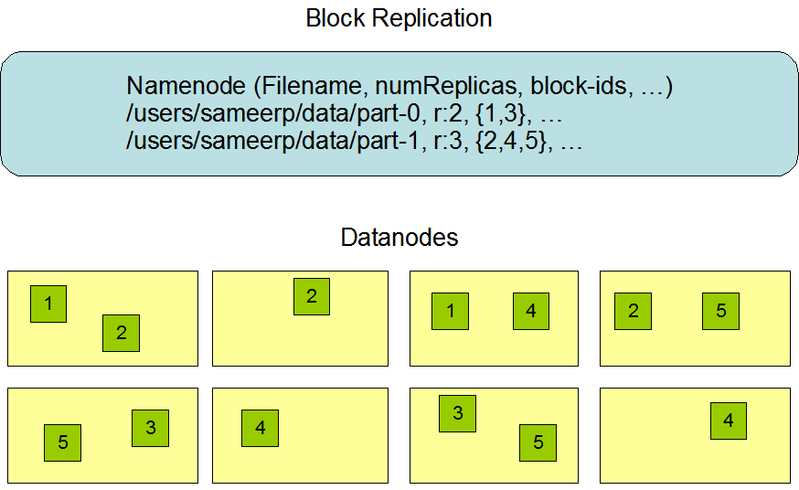
Architecture

Slide 10
HDFS Write/Read
When a client is writing data to an HDFS file, its data is first written to a local file, Suppose the HDFS file has a replication factor of three, When the local file accumulates a full block of user data, the client retrieves a list of DataNodes from the NameNode. This list (Data pipeline) contains the DataNodes that will host a replica of that block.
The client then flushes the data block to the first DataNode.
The first Datanode starts receiving the data in small portions (4 KB), writes each portion to its local repository and transfers that portion to the second DataNode.
The second DataNode, in turn starts receiving each portion of the data block, writes that portion to its repository and then flushes that portion to the third DataNode.
Finally, the third DataNode writes the data to its local repository. Thus, a DataNode can be receiving data from the previous one in the pipeline and at the same time forwarding data to the next one in the pipeline.
To read/open a file, client contacts the name node retrieves list of locations of blocks of that file. These locations identify data nodes that hold the block. Clients then read the data directly from data nodes in parallel. Name Node is not involved in this stage.

Slide 11
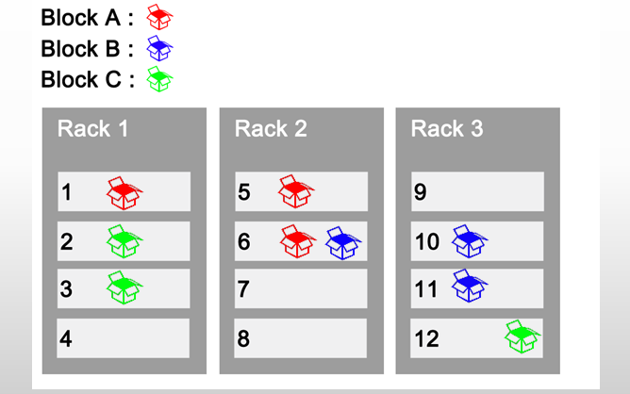
HDFS Features
Data is distributed over several machines, and replicated to ensure their durability to failure and high availability to parallel applications
Each block 128Mb in size, this is to keep smaller metadata at name node for each file and reduce seek time.
Since several machines are involved in serving a file, loss of machine can result in failure of servicing the file request. Hence it replicate each block across a number of machines (3 by default).
Rack Awareness
Typically large Hadoop clusters are arranged in racks and network traffic between different nodes with in the same rack is much more desirable than network traffic across the racks.
In addition NameNode tries to place replicas of block on multiple racks for improved fault tolerance.
Current Strategy
One replica on local node
Second replica on a remote rack
Third replica on same remote rack
Additional replicas are randomly placed
Clients read from nearest replica.

Slide 12
HDFS Features
Scalable horizontally by adding new nodes
Write once and read many times (write is costly)
Designed for very large files (TBs), so possible that a block of data fetched from a datanode arrives corrupted due to faults in a storage device, network faults, or buggy software.
The HDFS client software implements checksum per 512 byte (CRC32) checking on the contents of HDFS files. When a client creates an HDFS file, it computes a checksum of each block of the file and stores these checksums in a separate hidden file in the same HDFS namespace. (Datanode stores the checksum)
When a client retrieves file contents it verifies that the data it received from each Datanode matches the checksum stored in the associated checksum file. If not matching, then the client retrieves that block from another Datanode that has a replica of that block.
Unix like commands interface
HADOOP runs as a separate process and in a different namespace isolated from normal FS on the OS. HDFS files/blocks are stored in a particular directory controlled by Datanode. Files are stored with block Ids. You can't interact with them using normal Unix commands.

Slide 13
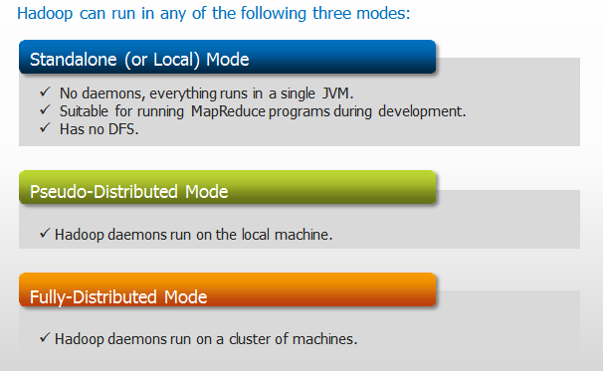
Hadoop Cluster Modes
Web UI URLs
NameNode status: http://localhost:50070/dfshealth.jsp
ResourceManager status: http://localhost:8088/cluster
MapReduce JobHistory Server status: http://localhost:19888/jobhistory

Slide 14
Hadoop Configuration Files
Configuration Filenames | Description of Log Files
hadoop-env.sh | Environment variables that are used in the scripts to run Hadoop.
core-site.xml | Configuration settings for Hadoop Core such as I/O settings that are common to HDFS and MapReduce.
hdfs-site.xml | Configuration settings for HDFS daemons, the namenode, the secondary namenode and the data nodes.
mapred-site.xml | Configuration settings for MapReduce Applications.
yarn-site.xml | Configuration settings for ResourceManager and NodeManager.
masters | Contains a list of hosts, one per line, that are to host Secondary NameNode servers.
slaves | A list of machines (one per line) that each run a Datanode and a NodeManager.
All Properties
https://hadoop.apache.org/docs/current/hadoop-project-dist/hadoop-common/core-default.xml
https://hadoop.apache.org/docs/current/hadoop-project-dist/hadoop-hdfs/hdfs-default.xml
https://hadoop.apache.org/docs/current/hadoop-mapreduce-client/hadoop-mapreduce-client-core/mapred-default.xml
https://hadoop.apache.org/docs/current/hadoop-yarn/hadoop-yarn-common/yarn-default.xml
https://hadoop.apache.org/docs/current/hadoop-project-dist/hadoop-common/DeprecatedProperties.html

Slide 15
HDFS Federation
The NameNode keeps a reference to every file and block in the filesystem in it’s main memory, which means that on very large clusters with many files, memory becomes the limiting factor for scaling.
HDFS federation, introduced in the 2.x release series, allows a cluster to add multiple NameNodes, each of which manages a portion of the filesystem namespace. For example, one NameNode might manage all the files rooted under /Marketing, say, and a second NameNode might handle files under /Sales.
Under federation, each NameNode manages a namespace volume, which is made up of the metadata for the namespace, and a block pool containing all the blocks for the files in the namespace.
Namespace volumes are independent of each other, which means NameNodes do not communicate with one another, and furthermore the failure of one NameNode does not affect the availability of the namespaces managed by other NameNodes.
Block pool storage is not partitioned, so datanodes register with each NameNode in the cluster and store blocks from multiple block pools.

Slide 16
HDFS High Availability
Prior to Hadoop 2.0.0, the NameNode was a single point of failure (SPOF) in an HDFS cluster as each cluster had a single NameNode, and if that machine or process became unavailable, the cluster as a whole would be unavailable until the NameNode was either restarted or brought up on a separate machine until NameNode comes out of Safemode.
This impacted the total availability of the HDFS cluster in two major ways:
In the case of an unplanned event such as a machine crash, the cluster would be unavailable until an operator restarted the NameNode.
Planned maintenance events such as software or hardware upgrades on the NameNode machine would result in windows of cluster downtime.
The HDFS High Availability feature addresses the above problems by providing the option of running two separate machines are configured as NameNodes. At any point in time, exactly one of the NameNodes is in an Active state, and the other is in a Standby state.
The Active NameNode is responsible for all client operations in the cluster, while the Standby is simply acting as a slave, maintaining enough state to provide a fast failover if necessary.
In order to provide a fast failover, the DataNodes are configured with the location of both NameNodes, and send block location information and heartbeats to both.
Note that, in an HA cluster, the Standby NameNode also performs checkpoints of the namespace state, and thus it is not necessary to run a Secondary NameNode.

Slide 17
HA (Architecture)
NFS for shared storage
When any namespace modification is performed by the Active node, it durably logs a record of the modification to an edit log file stored in the shared directory (NFS). Typically this is a remote filer which supports NFS and is mounted on each of the NameNode machines. The Standby node is constantly watching this directory for edits, and as it sees the edits, it applies them to its own namespace.
In the event of a failover, the Standby will ensure that it has read all of the edits from the shared storage before promoting itself to the Active state. This ensures that the namespace state is fully synchronized before a failover occurs.
Currently only a single shared edits directory is supported. Because of this, it is recommended that the shared storage server be a high-quality dedicated NAS appliance rather than a simple Linux server.
Quorum Journal Manager (QJM)
In order for the Standby NameNode to keep its state synchronized with the Active node, both NameNodes communicate with a group of separate daemons called “JournalNodes” (JNs). When any namespace modification is performed by the Active node, it durably logs a record of the modification to a majority of these JNs. The Standby node is capable of reading the edits from the JNs, and is constantly watching them for changes to the edit log. As the Standby Node sees the edits, it applies them to its own namespace.
In the event of a failover, the Standby will ensure that it has read all of the edits from the JournalNodes before promoting itself to the Active state. This ensures that the namespace state is fully synchronized before a failover occurs.
you should run an odd number of JNs, (i.e. 3, 5, 7, etc.). Note that when running with N JournalNodes, the system can tolerate at most (N - 1) / 2 failures and continue to function normally.

Slide 18
Automatic failover
In HA mode, the system will not automatically trigger a failover from the active to the standby NameNode, even if the active node has failed. It needs, Apache ZooKeeper which is a highly available service for maintaining small amounts of coordination data, notifying clients of changes in that data, and monitoring clients for failures. The implementation of automatic HDFS failover relies on ZooKeeper for the following things:
Failure detection - each of the NameNode machines in the cluster maintains a persistent session in ZooKeeper. If the machine crashes, the ZooKeeper session will expire, notifying the other NameNode that a failover should be triggered.
Active NameNode election - ZooKeeper provides a simple mechanism to exclusively elect a node as active. If the current active NameNode crashes, another node may take a special exclusive lock in ZooKeeper indicating that it should become the next active.

Slide 19











Hadoop Eco-System
Apache Oozie (Workflow)
Hive
DW System
Pig Latin
Data Analysis
Mahout
Machine Learning
MapReduce Framework
HBase
HDFS (Hadoop Distributed File System)
Flume Sqoop
Import Or Export
Unstructured or
Semi-Structured data
Structured Data

Slide 20
HDFS FS Commands
Return the help for an individual command.
hadoop fs -usage command
Append single/multiple sources from local file system to the destination file system.
hadoop fs -appendToFile localfile1 localfile2 /user/hadoop/hadoopfile
hadoop fs -appendToFile localfile hdfs://nn.example.com/hadoop/hadoopfile
To view contents of text file which is present in hadoop directory.
hadoop fs -cat -ignoreCrc /user/cloudera/hadoop/file1.txt
The -ignoreCrc option disables checkshum verification
hadoop fs -tail /user/cloudera/hadoop/file1.txt (Displays last kilobyte of the file)
Create a file of zero length
hadoop fs -touchz /user/cloudera/hadoop/file1.txt
An error is returned if the file exists with non-zero length.
Truncate all files that match the specified file pattern to the specified length.
hadoop fs -truncate 55 /user/hadoop/file1 /user/hadoop/file2
hadoop fs -truncate -w 127 hdfs://nn1.example.com/user/hadoop/file1
-w flag requests that command waits for block recovery to complete, if necessary.

Slide 21
HDFS FS Commands
Count the number of directories, files and bytes under the paths that match the specified file
hadoop fs -count hdfs://nn1.example.com/file1 hdfs://nn2.example.com/file2
hadoop fs -count -q hdfs://nn1.example.com/file1 (-q means show quotas)
hadoop fs -count -q -h hdfs://nn1.example.com/file1(-h option shows sizes in human readable format)
hadoop fs -count -q -h -v hdfs://nn1.example.com/file1(The -v option displays a header line)
List the contents of the root directory in HDFS
hadoop fs -ls /
-C: Display the paths of files and directories only.
-d: Directories are listed as plain files.
-h: Format file sizes in a human-readable fashion
-R: Recursively list subdirectories encountered.
-t: Sort output by modification time (most recent first).
-S: Sort output by file size.
-r: Reverse the sort order.
-u: Use access time rather than modification time for display and sorting.
-e: Display the erasure coding policy of files and directories only.

Slide 22
HDFS FS Commands
Create a new directory in HDFS.
hadoop fs -mkdir /user/cloudera/hadoop
Add file from local directory to directory created in HDFS
hadoop fs -put /home/cloudera/data/sample.txt /user/cloudera/hadoop
hadoop fs -copyFromLocal /home/cloudera/sample.txt /user/cloudera (Only from local system)
Add file from HDFS directory to the local directory
hadoop fs –get hadoop/purchases.txt /home/training/data
hadoop fs -copyToLocal hadoop/purchases.txt /home/training/data
Copy/move/delete files from source to destination.
hadoop fs -cp /user/hadoop/file1 /user/hadoop/file2
hadoop fs -cp /user/hadoop/file1 /user/hadoop/file2 /user/hadoop/dir
The -f option will overwrite the destination if it already exists.
hadoop fs -mv /user/cloudera/hadoop /data/hadoop
hadoop fs -rm /user/cloudera/hadoop/file1.txt. (delete a file)
hadoop fs -rm /user/cloudera/hadoop/* (Delete all files from the directory)
hadoop fs -rm -r hadoop/retail(remove the entire retail directory and all of its contents )
hadoop fs -rmdir /user/hadoop/emptydir (Deletes empty directory)
--ignore-fail-on-non-empty: When using wildcards, do not fail if a directory still contains files.

Slide 23
HDFS Admin Commands
Displays free space.
hadoop dfs -df /user/hadoop/dir1
Displays sizes/length of files and directories
hadoop fs -du /user/hadoop/dir1
The -s option will result the calculation done by going 1-level deep from the given path rather than the individual files
The -h option will format file sizes in a “human-readable” fashion
The -v option will display the names of columns as a header line.
Finds all files that match the specified expression and applies selected actions to them.
hadoop fs -find / -name test –print
Report the amount of space used and available on currently mounted filesystem
hadoop fs -df hdfs:/
Count number of directories, files and bytes for paths that match specified file pattern
hadoop fs -count hdfs:/
Run a DFS filesystem checking utility reporting missing or under replicated blocks.
hdfs fsck /

Slide 24
HDFS Admin Commands
You can start the NameNode in recovery mode
namenode –recover
When in recovery mode, the NameNode will interactively prompt you at the command line about possible courses of action you can take to recover your data. If you don't want to be prompted, you can give the -force option.
Returns the checksum information of a file.
hadoop fs -checksum hdfs://localhost/file1
hadoop fs -checksum file:///home/cloudera
Command to make the name node leave safe mode
hdfs dfsadmin -safemode leave
Recommission or decommission DataNode(s)
hadoop dfsadmin –refreshNodes (After adding the IP Address to slave file)
Balancer analyzes block placement and rebalances data across the Datanode.
hadoop balancer
Use ‘-setrep’ command to change replication factor of a file (default -3)
hadoop fs -setrep -w 2 apache_hadoop/sample.txt

Slide 25
HDFS Admin Commands
Change group association of files. The user must be the owner of files, or super-user.
hadoop fs -chgrp [-R] GROUP URI [URI ...]
Change the permissions of files.
hadoop fs -chmod [-R] <MODE[,MODE]... | OCTALMODE> URI [URI ...]
Change the owner of files. The user must be a super-user.
hadoop fs -chown [-R] [OWNER][:[GROUP]] URI [URI ]
The -R option will make the change recursively through the directory structure.
To empty the trash
hadoop fs –expunge
When a file is deleted by a user or an application, it is not immediately removed from HDFS. Instead, HDFS first renames it to a file in the /trash directory. The file can be restored quickly as long as it remains in /trash. After the expiry of its life in /trash, the NameNode deletes the file from the HDFS namespace. The deletion of a file causes the blocks associated with the file to be freed.
Note that there could be an appreciable time delay between the time a file is deleted by a user and the time of the corresponding increase in free space in HDFS.
The /trash directory contains only the latest copy of the file that was deleted.

Slide 26
Thank You

